Slide 1
Web Apps
Formerly websites

Slide 2
Web app services
Web app services are a combination of Platform as a Service (PaaS) and often Software as a Service (SaaS)
They host what are commonly or formerly known as websites

Slide 3

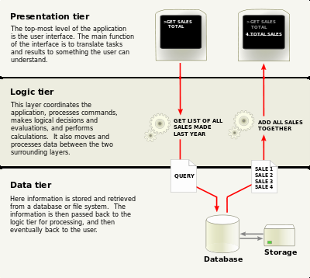
Different Tiers of a Web App Service

Slide 4
What is a Microsoft web app service?
In App Service, a web app is the compute resources that Azure provides for hosting a website or web application.
The compute resources may be on shared or dedicated virtual machines (VMs), depending on the pricing tier that you choose. Your application code runs in a managed VM that is isolated from other customers.
Your code can be in any language or framework that is supported by Azure App Service, such as ASP.NET, Node.js, Java, PHP, or Python. You can also run scripts that use PowerShell and other scripting languages in a web app.+
For examples of typical application scenarios that you can use Web Apps for, see Web app scenarios and the Scenarios and recommendations section of Azure App Service, Virtual Machines, Service Fabric, and Cloud Services comparison.

Slide 5
Why use Azure Web Apps services
Multiple languages and frameworks - App Service has first-class support for ASP.NET, Node.js, Java, PHP, and Python. You can also run PowerShell and other scripts or executables on App Service VMs.
DevOps optimization - Set up continuous integration and deployment with Visual Studio Team Services, GitHub, or BitBucket. Promote updates through test and staging environments. Perform A/B testing. Manage your apps in App Service by using Azure PowerShell or the cross-platform command-line interface (CLI).
Global scale with high availability - Scale up or out manually or automatically. Host your apps anywhere in Microsoft's global datacenter infrastructure, and the App Service SLA promises high availability.
Connections to SaaS platforms and on-premises data - Choose from more than 50 connectors for enterprise systems (such as SAP, Siebel, and Oracle), SaaS services (such as Salesforce and Office 365), and internet services (such as Facebook and Twitter). Access on-premises data using Hybrid Connections and Azure Virtual Networks.
Security and compliance - App Service is ISO, SOC, and PCI compliant.
Application templates - Choose from an extensive list of application templates in the Azure Marketplace that let you use a wizard to install popular open-source software such as WordPress, Joomla, and Drupal.
Visual Studio integration - Dedicated tools in Visual Studio streamline the work of creating, deploying, and debugging.

Slide 6
References
https://docs.microsoft.com/en-us/azure/app-service-web/app-service-web-overview
https://en.wikipedia.org/wiki/Multitier_architecture

